Slide 1

AI-Powered Default Risk Predictor for FinTech
Capstone 2 Project - Altamash Ansari
September 11, 2025
Notes:
1

Slide 2

Executive Summary
The Challenge
FinTech companies need real-time loan default risk assessment to maintain sustainable growth and minimize financial exposure.
Our Solution
Interactive Streamlit dashboard powered by machine learning models to predict default probabilities with explainable AI insights.
This project empowers credit analysts to forecast risks, visualize critical factors, and optimize loan approval processes through data-driven intelligence and comprehensive risk visualization.
Notes:
2

Slide 3

Problem Statement
Portfolio Management Gaps
Decision-Making Blindspots
Financial institutions manage extensive loan portfolios but lack integrated real-time tools for accurate default risk assessment across diverse applicant segments.
Without comprehensive visibility into applicant behavior patterns and credit history correlations, institutions face costly misjudgments leading to unexpected defaults.
Risk Mitigation Need
Insights Deficiency
The industry demands predictive, visual tools to identify risk patterns early, evaluate applicant profiles systematically, and mitigate financial losses proactively.
Traditional risk models can’t predict future defaults as applicant profiles change, leaving institutions unprepared for market shifts and exposing them to heavy losses and weaker portfolios.
Notes:
3

Slide 4

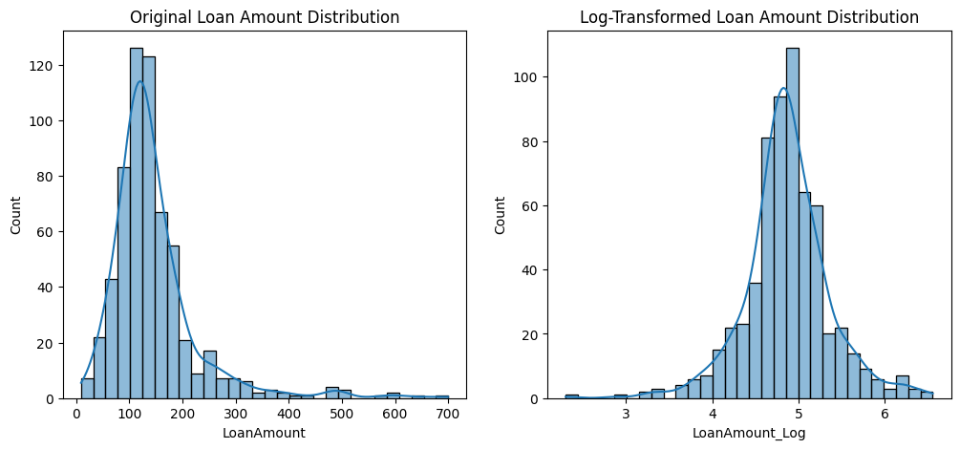
Methodology Framework
1.
Data Integration & Feature Engineering
Dataset cleaning and enhancement with DTI ratios, loan-to-income metrics, and log-transformed features. SMOTE implementation addresses class imbalance for robust model training.
The original loan amounts (left) are highly skewed. After log transformation (right), the distribution becomes more balanced, improving feature quality for model training
help stabilize variance, improve interpretability, and strengthen model training.
Notes:
5

Slide 5
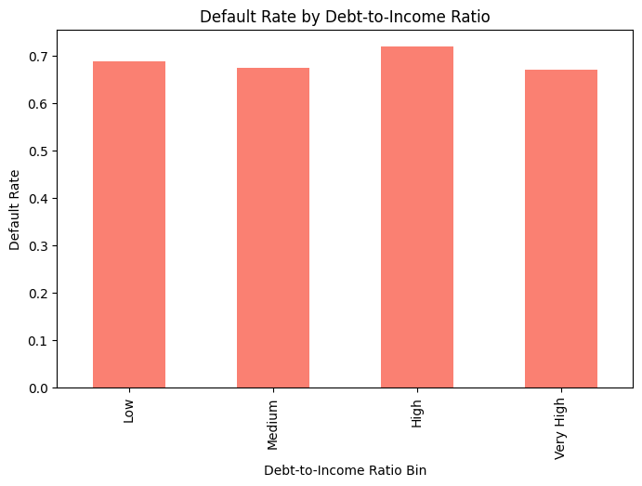
Methodology Framework
1.
Data Integration & Feature Engineering
Dataset cleaning and enhancement with DTI ratios, loan-to-income metrics, and log-transformed features. SMOTE implementation addresses class imbalance for robust model training.
Default rates remain high across all Debt-to-Income (DTI) categories, with only slight variation. This shows that DTI alone is not a strong predictor, highlighting the need for multi-feature AI modeling for accurate risk assessment
Notes:
5

Slide 6
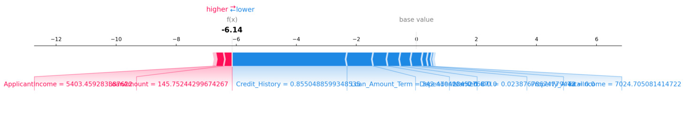
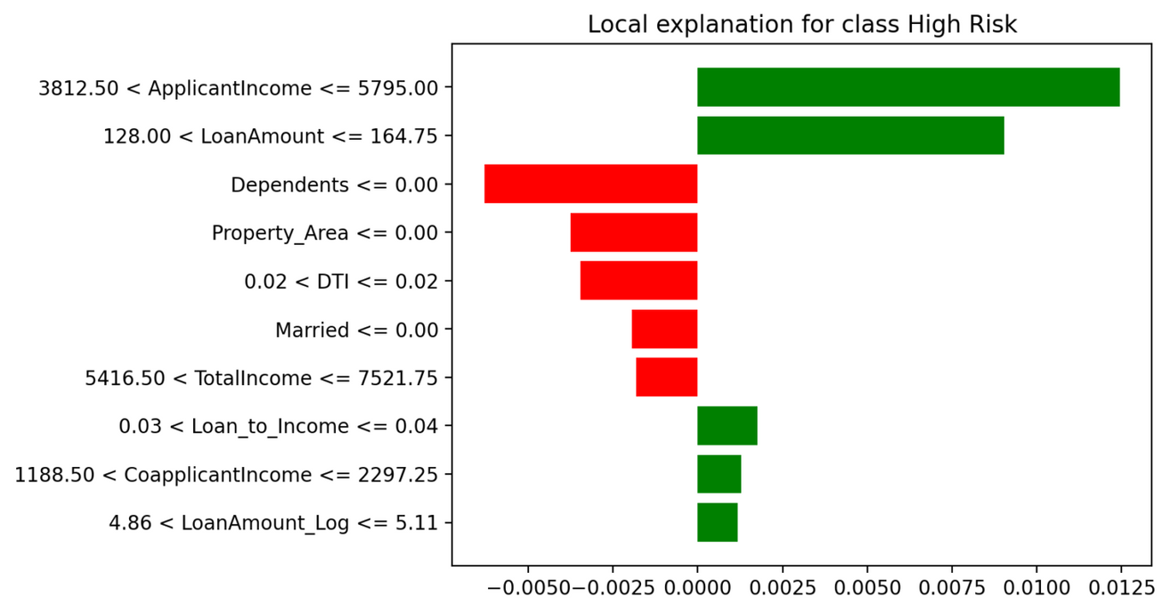
Methodology Framework
2.
Advanced Visualization Strategy
Default risk distribution mapping, probability heatmaps, SHAP-based factor explanations, and time-series trend analysis across segments for actionable insights.
The first plot (local explanation) highlights the most important factors influencing a decision for a specific applicant (positive vs negative contribution).
The second plot (SHAP force plot) shows how each feature pushes the prediction toward "high risk" or "low risk".
Notes:
5

Slide 7




Expected Business Outcomes
Comprehensive Risk Visibility
Precise Default Forecasting
360-degree view of default risk patterns across diverse applicant profiles with real-time probability assessments and trend identification.
Accurate probability predictions using segment-level trends and historical patterns to minimize unexpected losses and optimize approval rates.
High-Risk Segment Detection
Data-Driven Policy Support
Early identification of problematic applicant segments and process bottlenecks enabling proactive risk management strategies.
Strategic segmentation insights supporting enhanced credit risk management policies and evidence-based decision-making frameworks.
Notes:
6

